Slide 1
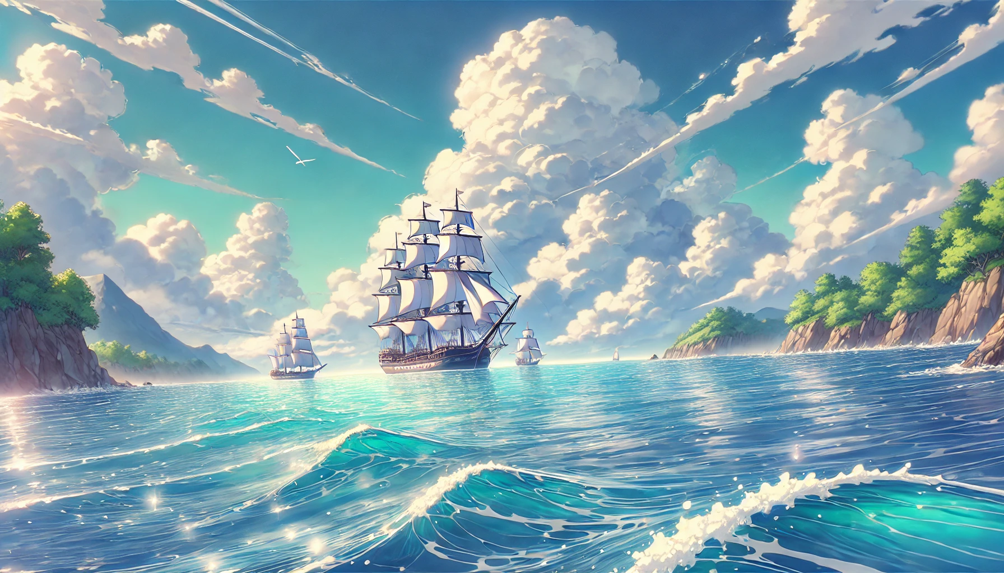

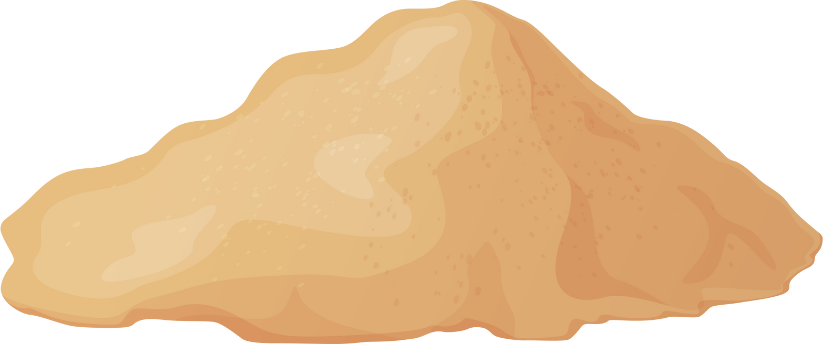
The
Skybound
Gold
Game Design Doc

Slide 2
Backstory – The Skybound Gold
Pat the Mag. A lone pirate who pursued the legend of the Skybound Gold. A treasure cursed by greed, said to be impossible to hold onto. "Whoever lays claim to it shall never rise without losing what they gained."
But Pat wasn’t driven by wealth. He wanted freedom for his people, who were enslaved by the Marines and their abusive militia. With only his battered ship and a Jolly Roger featuring a Magpie, Pat vowed to gather enough treasure to buy his hometown’s sovereignty and break free from the Marines' grip.
Against all odds, Pat found the Skybound Gold on an unmarked island. But as soon as he touched the treasure, the curse activated, scattering his gold every time he jumped. Worse, the Marines, have tracked him down.
With the curse dragging him down and enemies closing in, Pat must escape the island and secure enough gold to fulfil his dream of buying his people freedom.

Slide 3
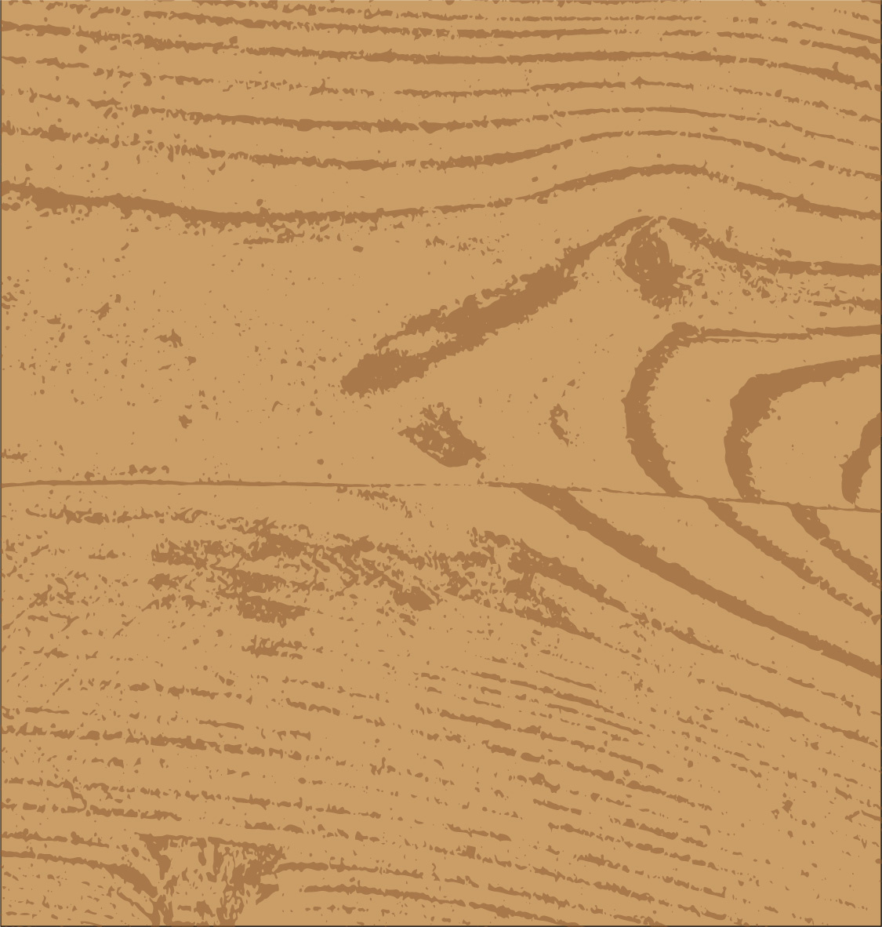
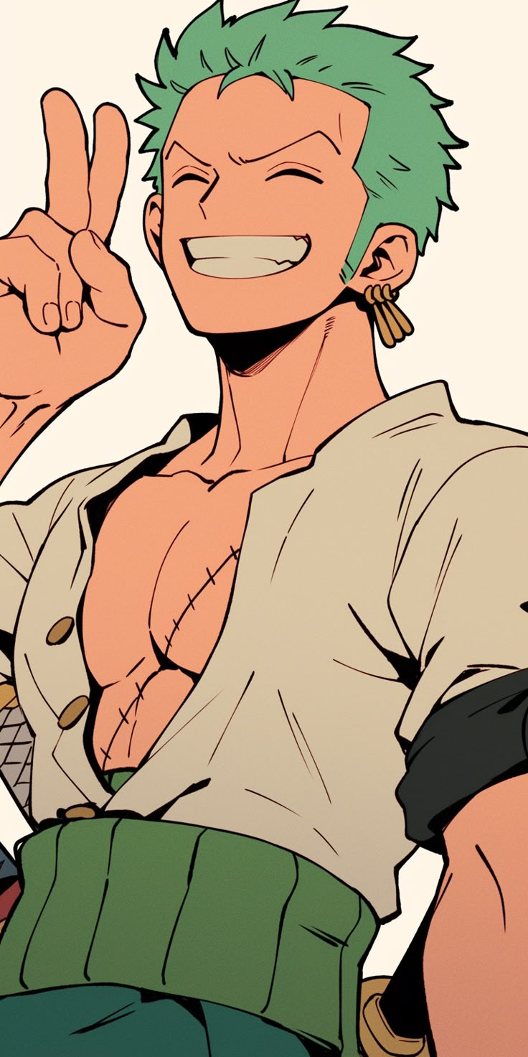
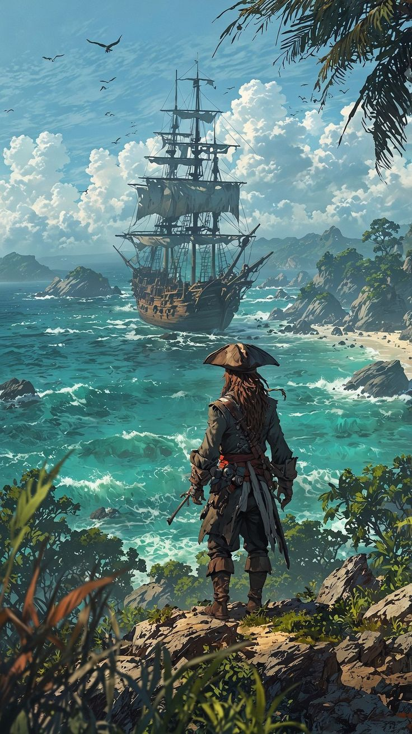
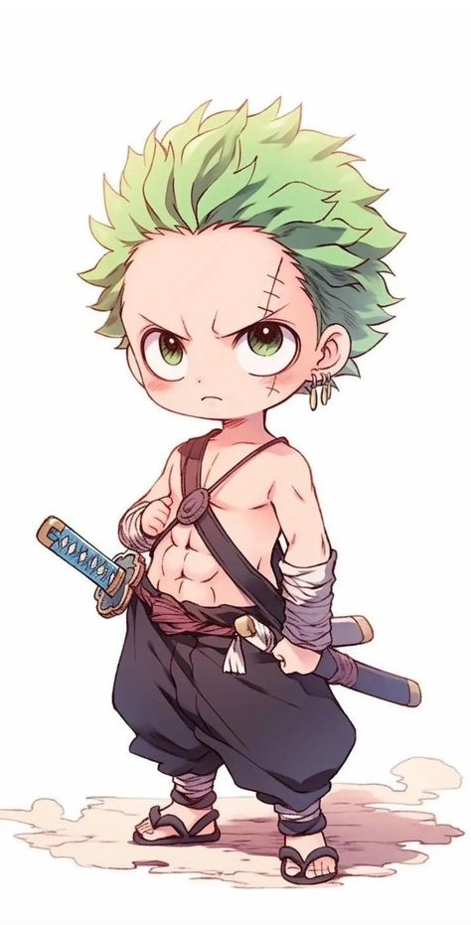

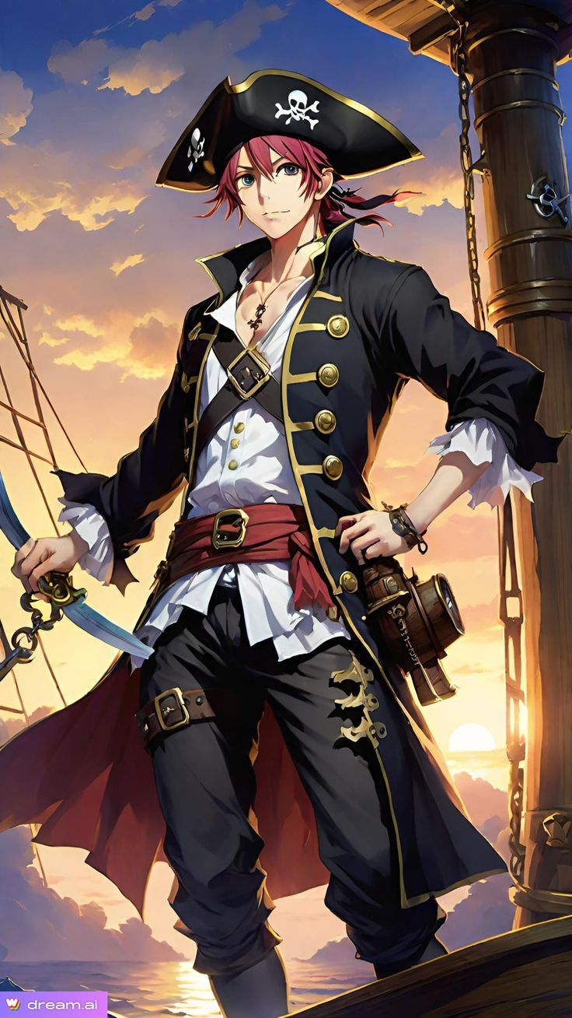
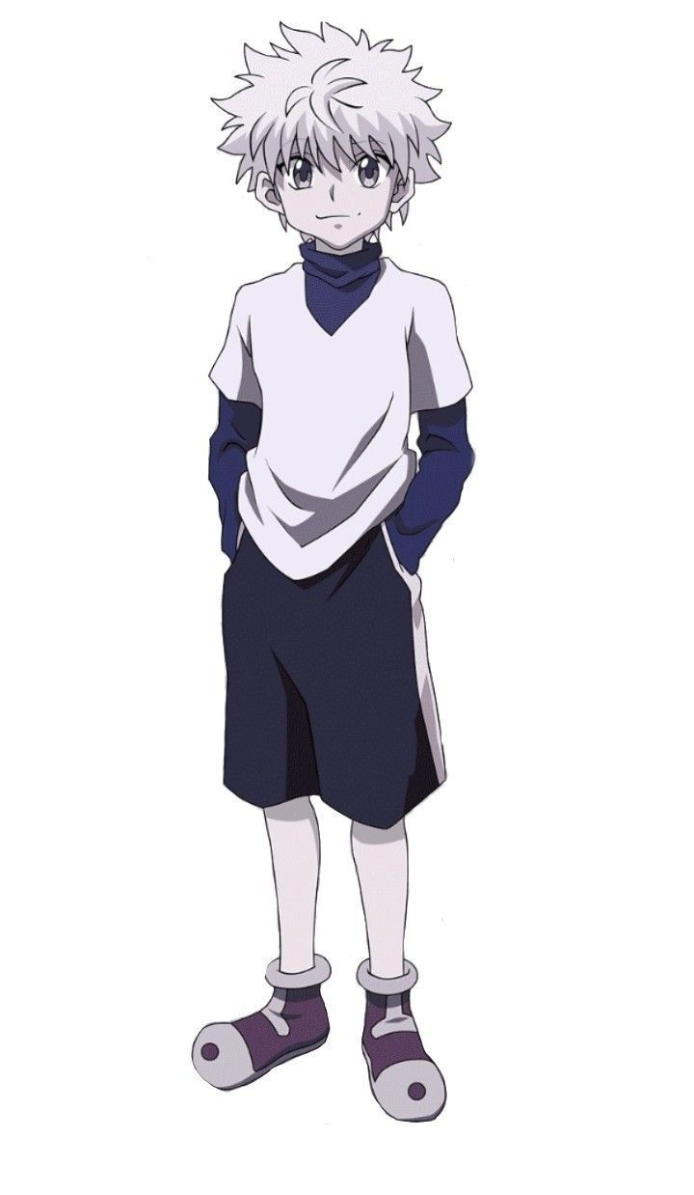


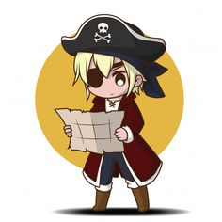
Character Mood Board

Slide 4
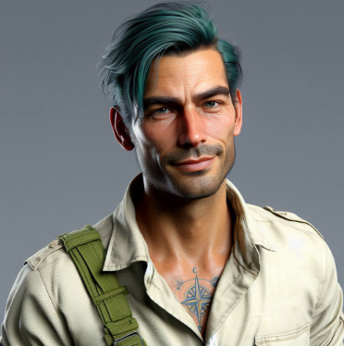
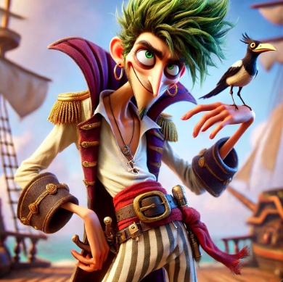
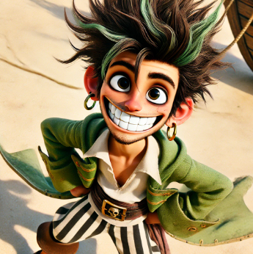
Character Mashups (AI)

Slide 5

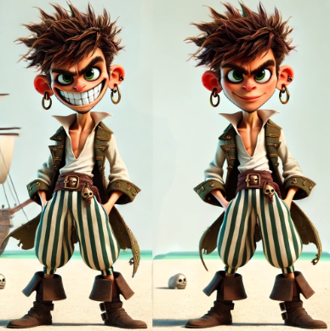
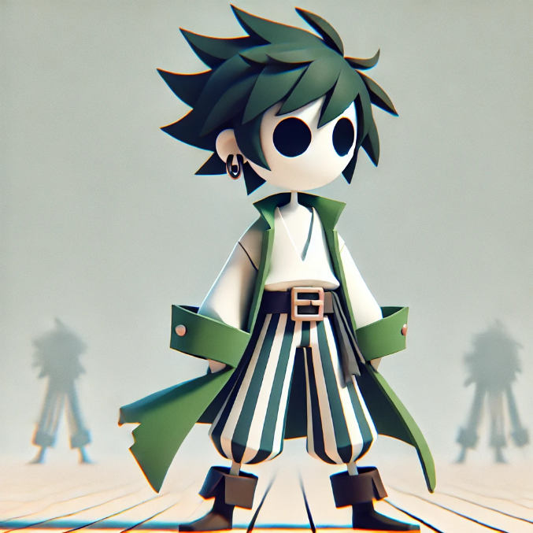
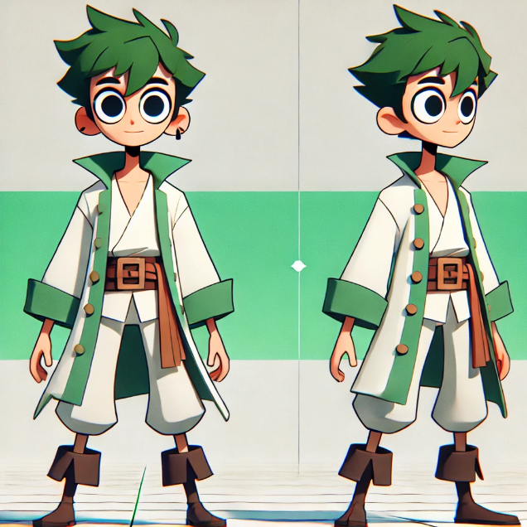
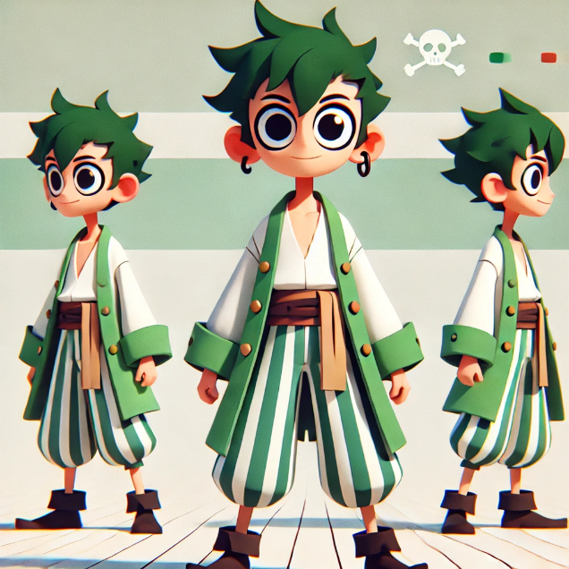
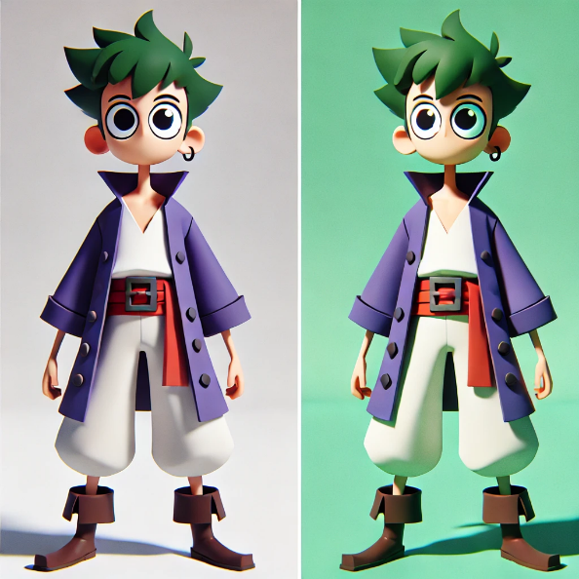
Character Model Refinement (AI)

Slide 6

The Character
Pat the Mag
Colour Palette
Age: 23
Characteristics:
Agile
Fearless
Stronger than he looks
Personality:
Loyal
Brave
Friendly
Good hearted
Loves Magpies
Appreciates freedom

Slide 7
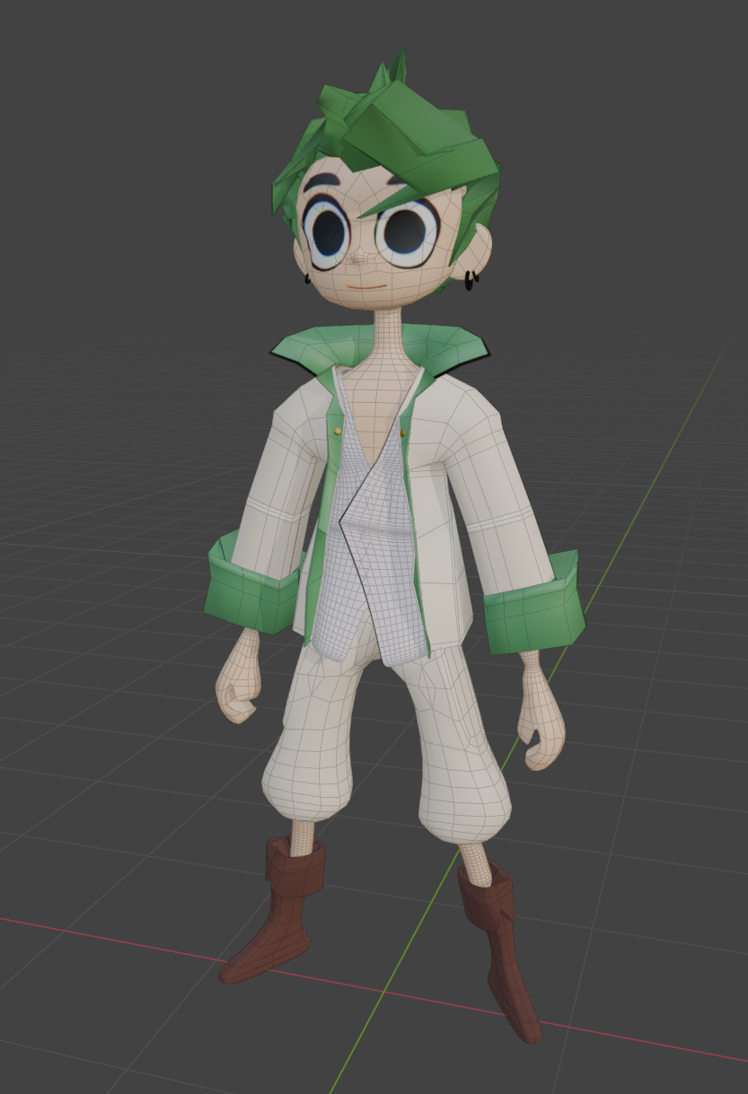
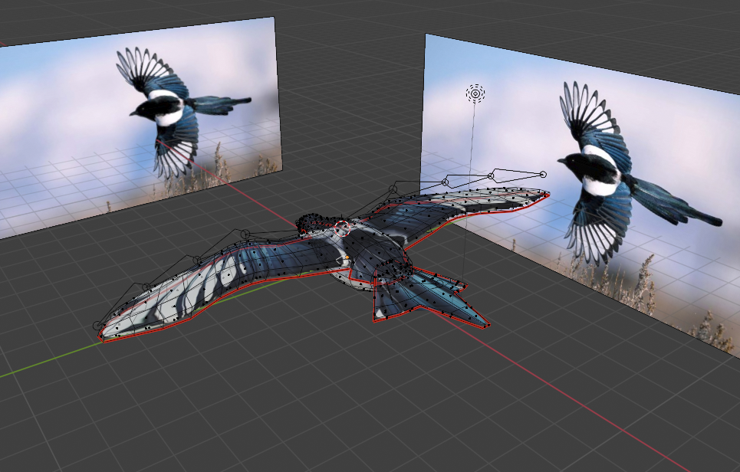
3D Models - Blender

Slide 8
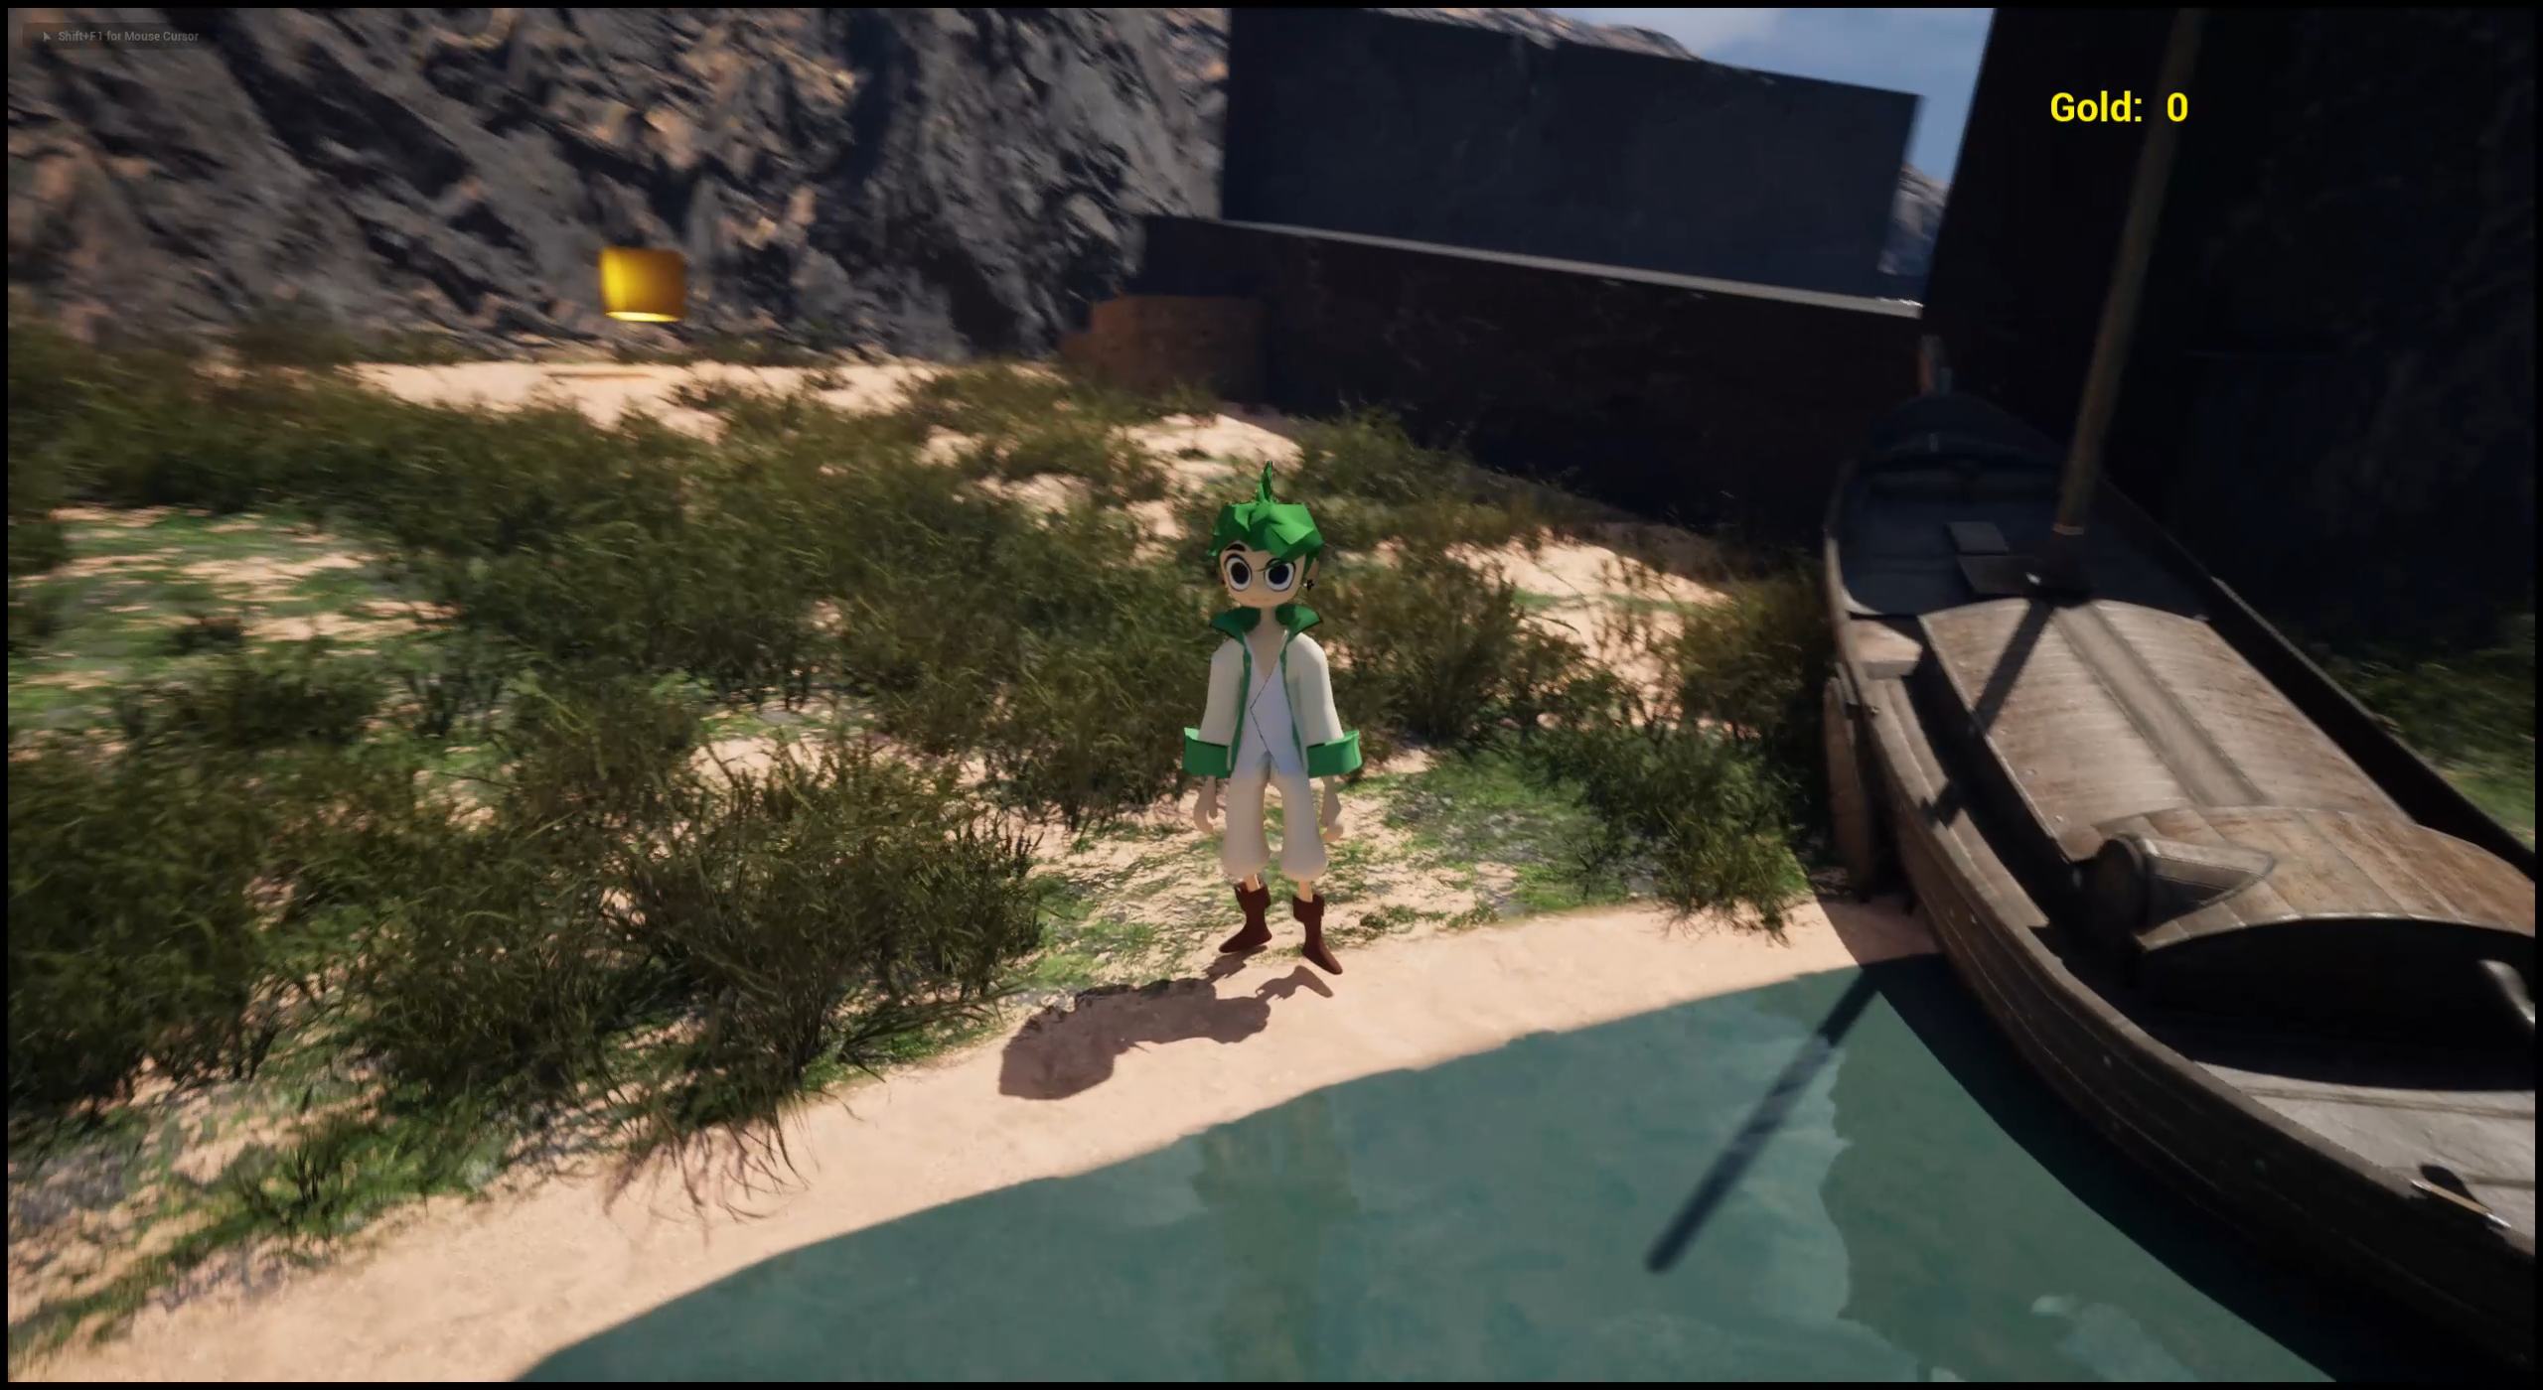
3D Model - Animations
Neutral
Walk/Run
Jumping up
Jumping down
Falling (mid air)

Slide 9
Mechanics – Controls
Movement
W
E
Collect Treasure
A
S
D
Space Bar
Jump

Slide 10
Mechanics – Environment Challenges
01
02
Skybound Curse
When Pat the Mag has the Skybound gold on him, when he jumps, he loses a bit of gold.
The Island
wants its gold
As Pat gets the gold, the island will start sinking to try to protect its gold

Slide 11








Mechanics - Obstacles
Quicksand
Moving Platforms
Marines’ Attack
Quicksand will make Pat sink. He’ll have to jump many times to leave it. The problem is that it will cost him some gold to do it!
The Island will have some ancient and cursed platforms. Falling from them will be fatal!
Marines will shoot at Pat! He is a strong pirate, but if he is hit, he will lose a good amount of gold!
!

Slide 12

01
Game Objectives
03
Defy Obstacles
Have gold to buy Pat’s people freedom
Find Skybound Gold
02

Slide 13


Win/Loss Conditions
Win
Partial Win
Loss
Pat gets to the top of the island with enough money to save all his people.
Pat gets to the top of the island, but he doesn’t have enough gold to save all his people.
Pat get’s caught by the water of the sinking island;
Pat fully sinks in a quicksand.

Slide 14
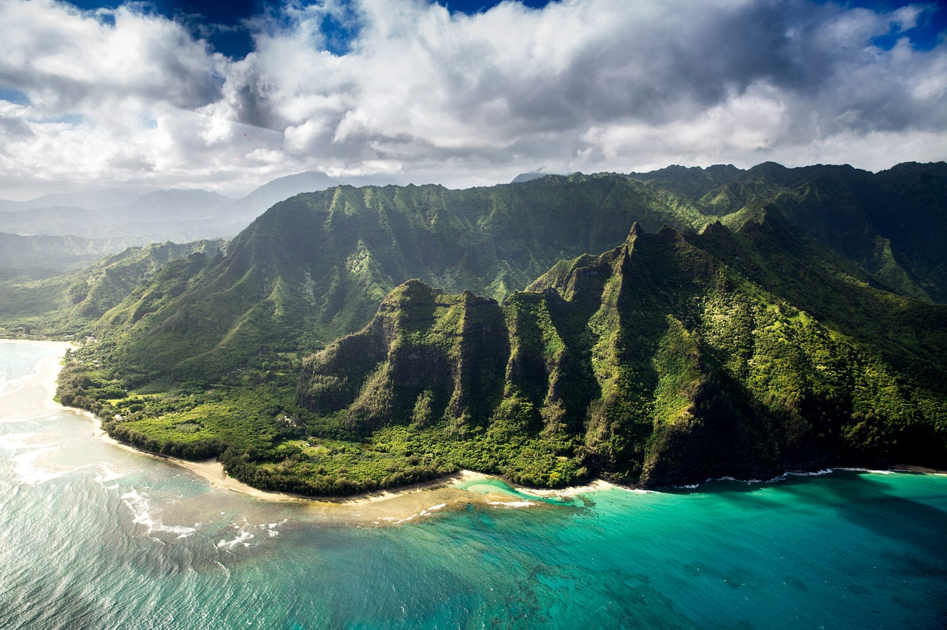
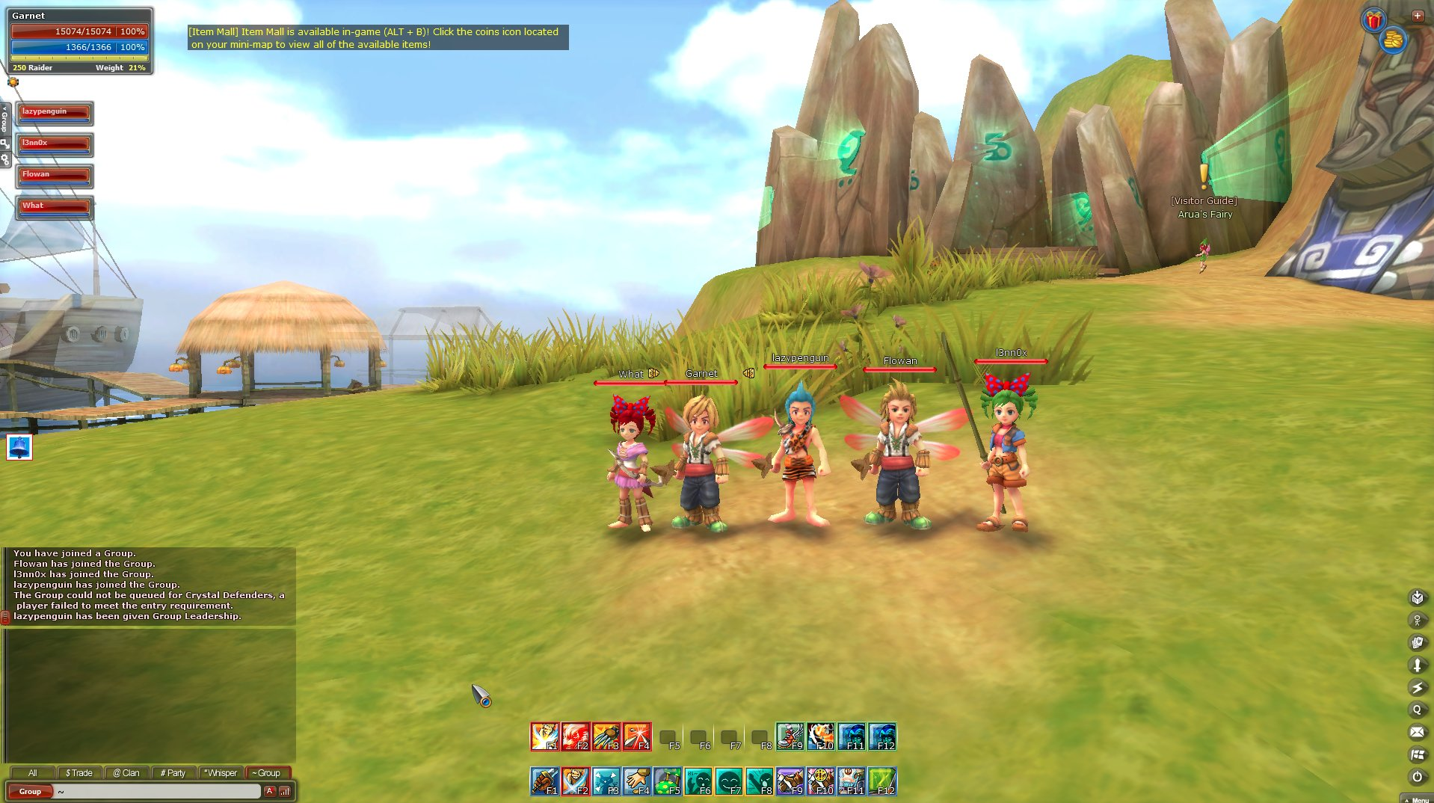
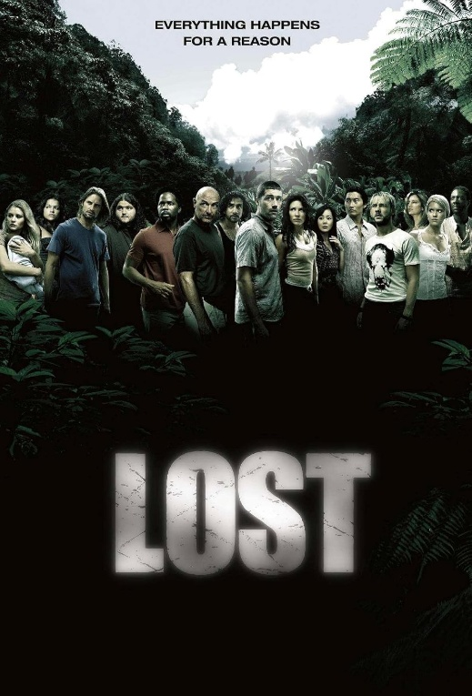

Map Design – References/Inspiration

Slide 15
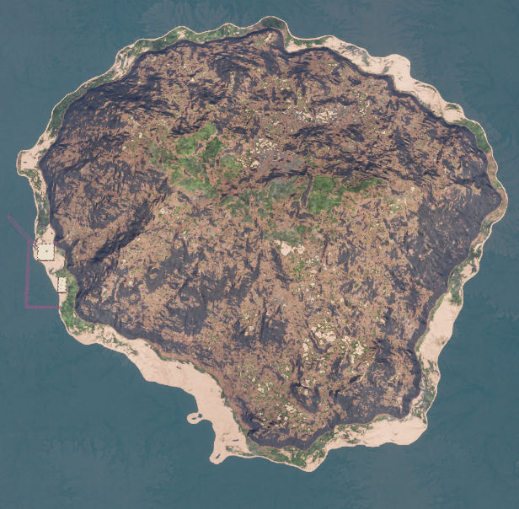
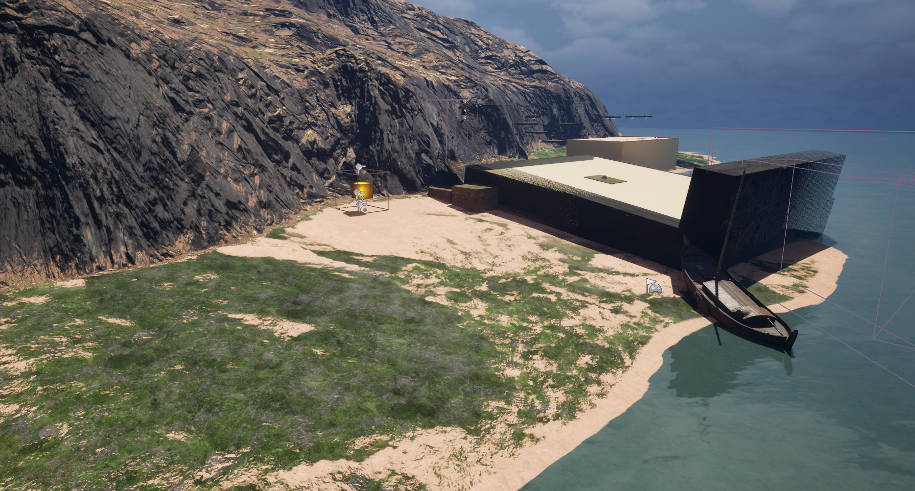
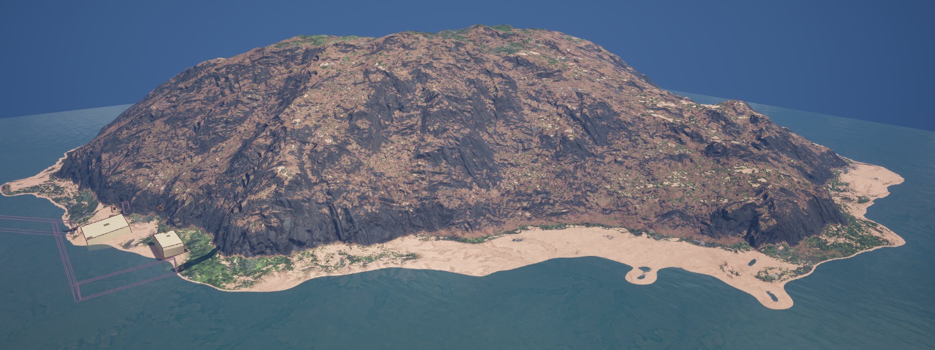
Level Design – The Island
An island
Pat will start from the shore
Find the treasure
Be exposed to challenges
Challenges get progressively harder
Pat is led to the top of the mountain

Slide 16
Level Design – Pat’s Path
Quicksand “tutorial”
Quicksand + Platforms + Marines
Moving Platforms
Platforms + Marines
Heavy Marine’s attack
from ships

Slide 17
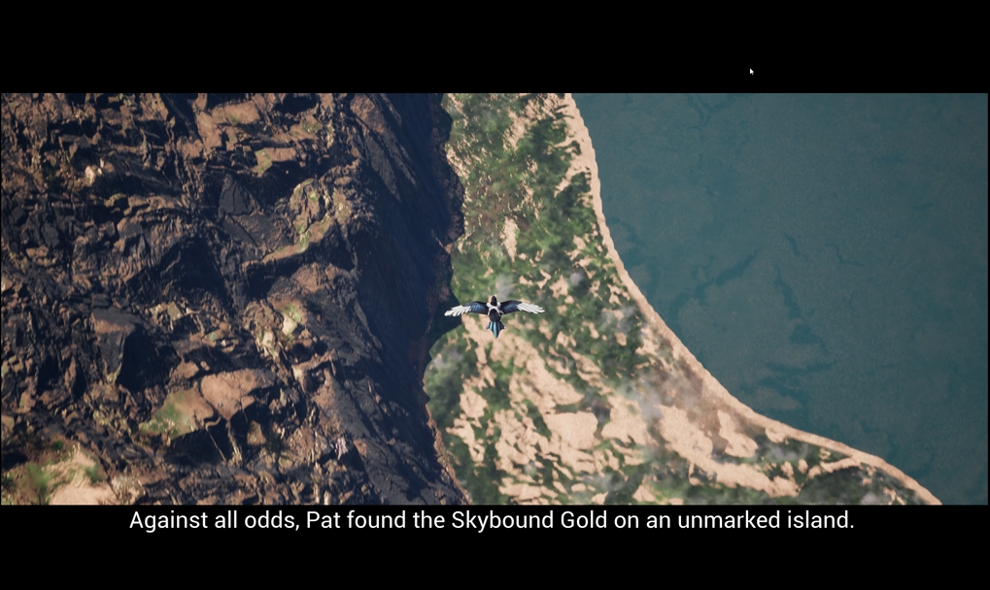
Narrative
Cinematic
Treasures
Path to the top
Tell the player the character motivation and backstory.
Camera transition from a Magpie flying to Pat (3rd person)
Treasures aren’t always worth the risk. It’s up to the player to judge if they will try to jump and lose some coins to get a few more from the chest.
The player can make their own path.
The game will try to lead the player to the top of the mountain.
By showing treasures along the way, hard challenges in others, visual cues (like a path of trees), we want the player to follow instinctively to the top of the mountain.

Slide 18
Sound Design
Music (BGM)
Sound Effects
Voice Over
Adventure, epic, heroic, cinematic sound that makes player challenged but still enthusiastic to reach to the end of the level.
jumping
Walking (footsteps)
Coins falling (when jumping or being hit)
Cannon firing
Sea shore
Opening Chest
Picking Coins
Backstory to be voiced over and used in cinematic intro
Pat the Mag
“Nice”/”wow”
“Ouch”

Slide 19
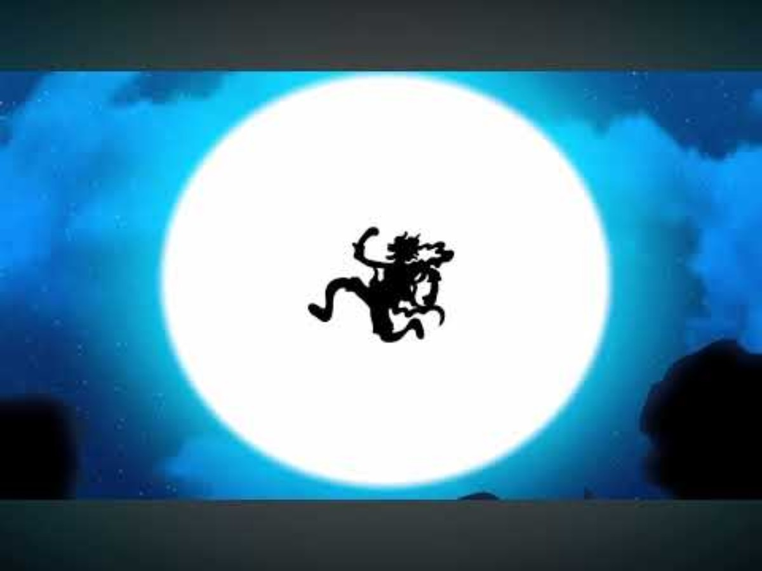
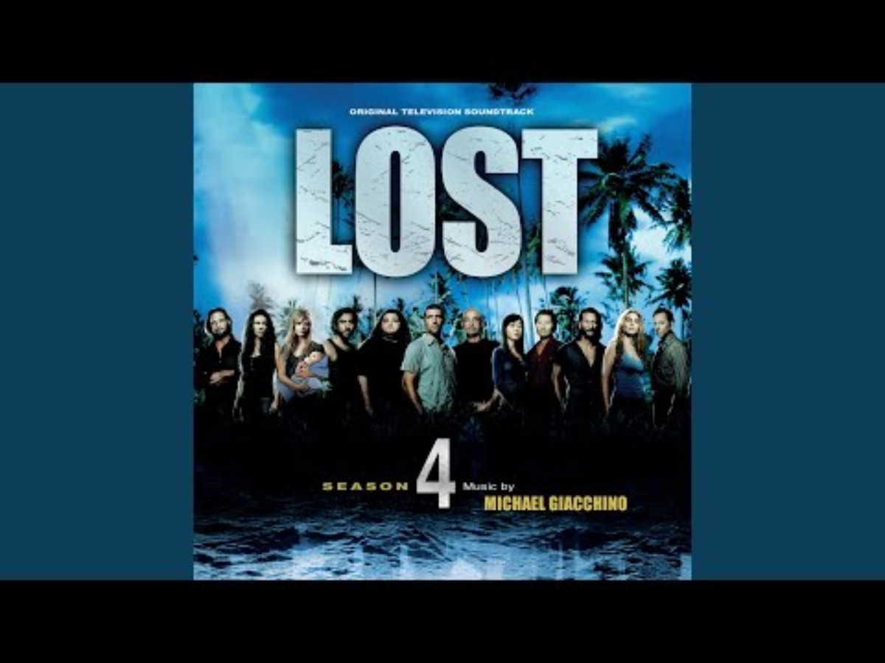
Sound Design – BGM Reference/Inspiration
Drums of Liberation
(Anime: One Piece)
Ji Yeon
(Michael Giacchino – Lost Soundtrack)

Slide 20
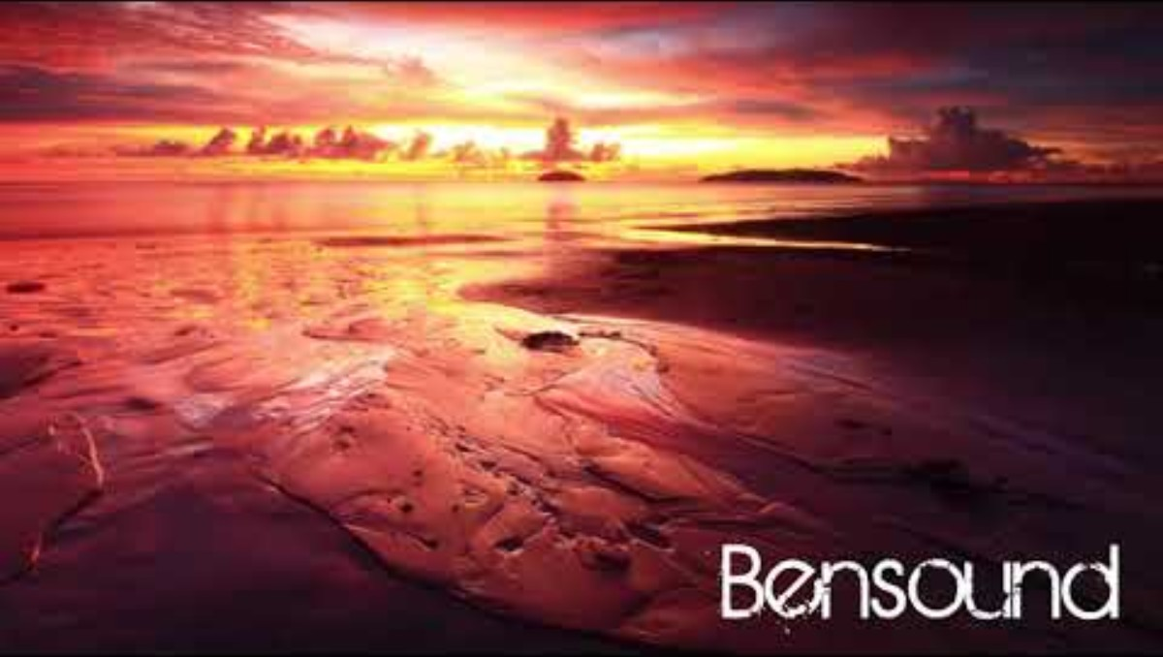
Sound Design – BGM Chosen
Birth of a Hero - Bensound.com | Artist: Benjamin Tissot

Slide 21
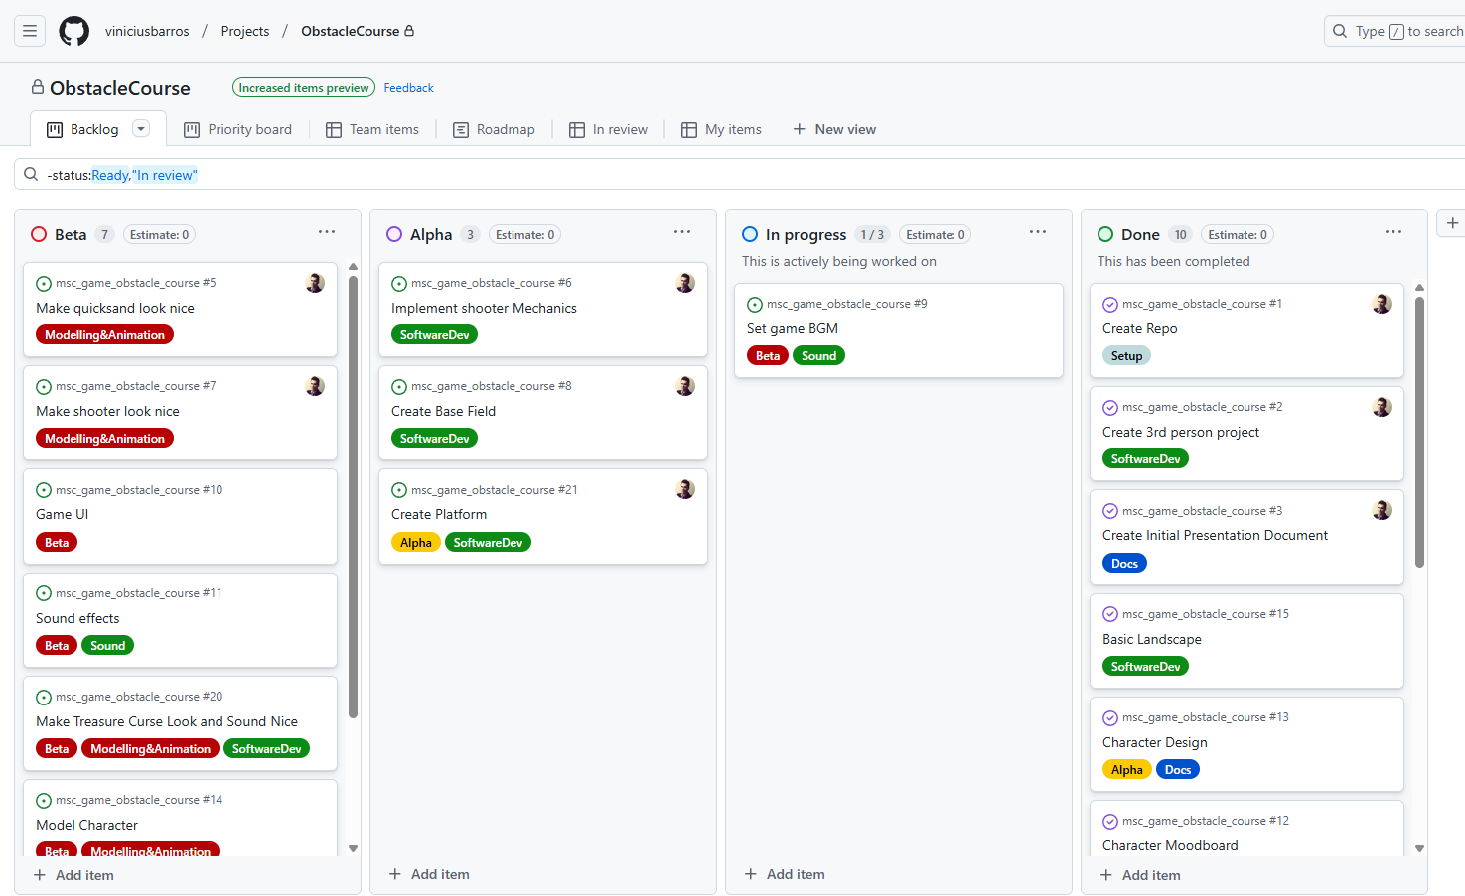
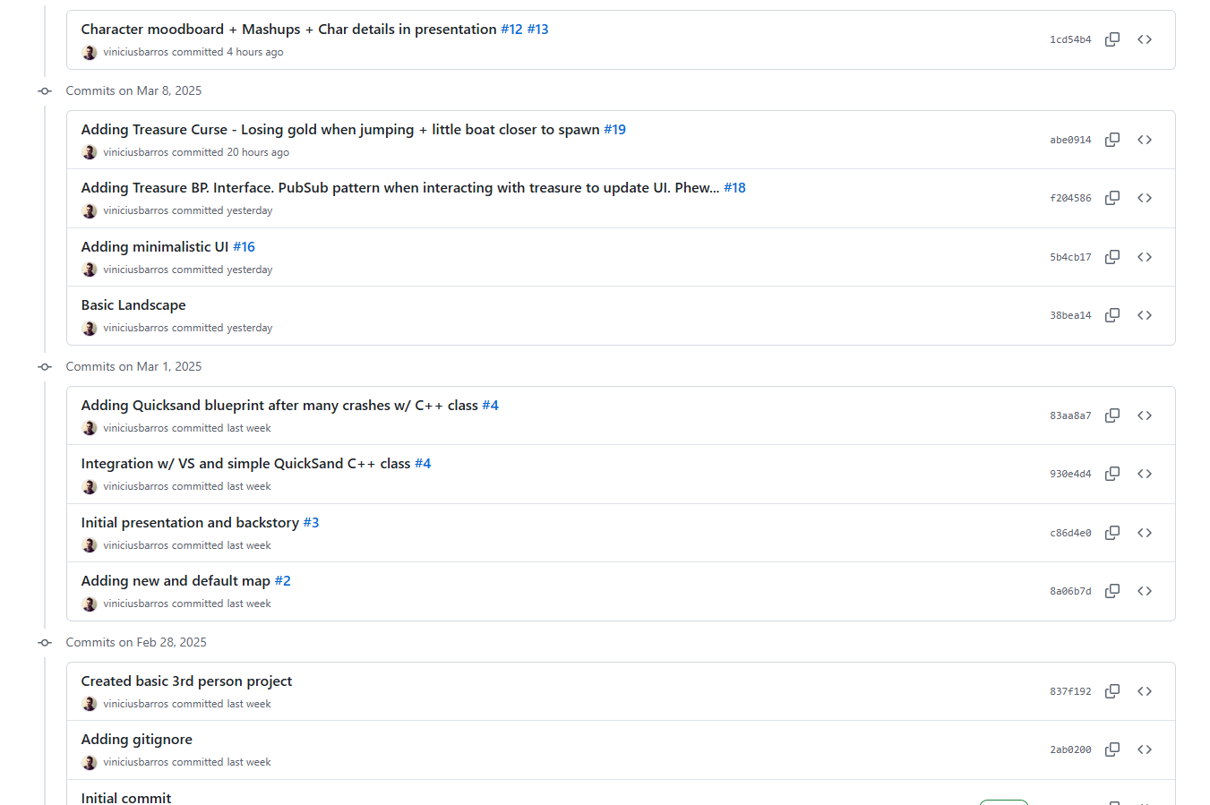
Development Tracking & Source Control
GitHub Repository
Kanban Board (GitHub Project)
1 task at a time
4 columns:
Beta
Alpha
In Progress
Done

Slide 22
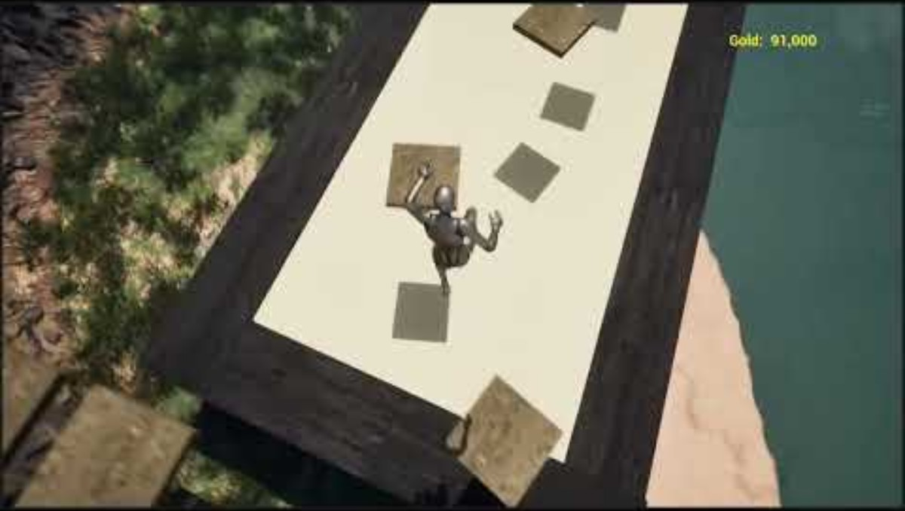
Greybox Gameplay

Slide 23
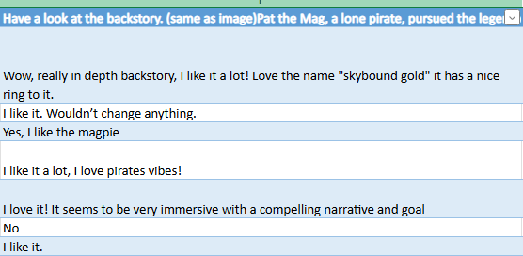
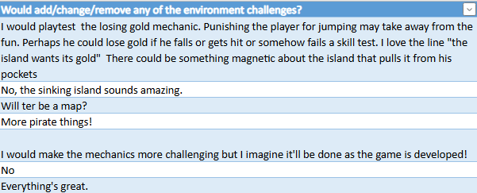
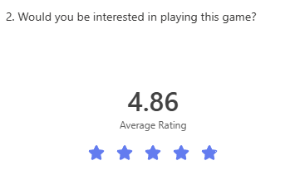
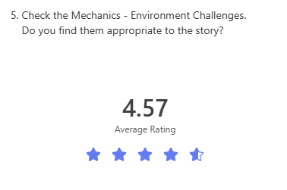
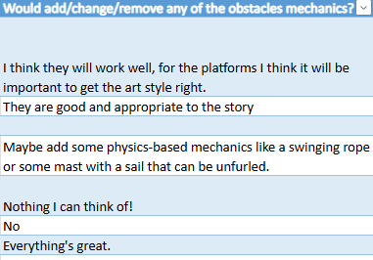
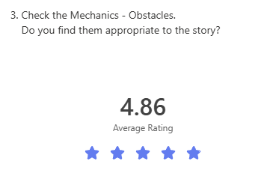
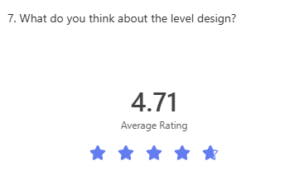
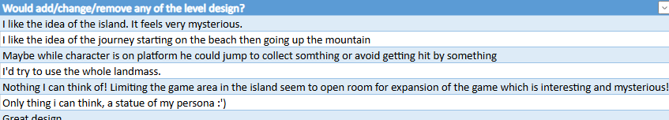
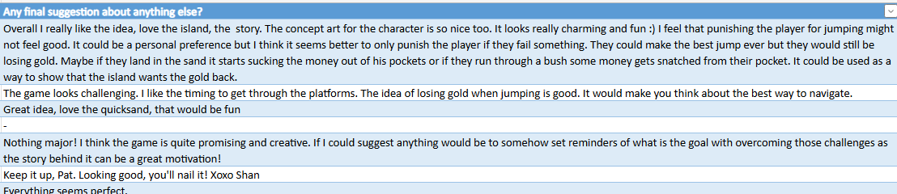
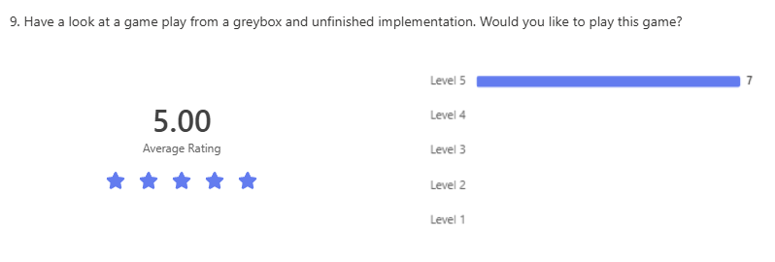









Concept/Greybox Feedback
10 questions asked in Online Form
7 answers so far

Slide 24
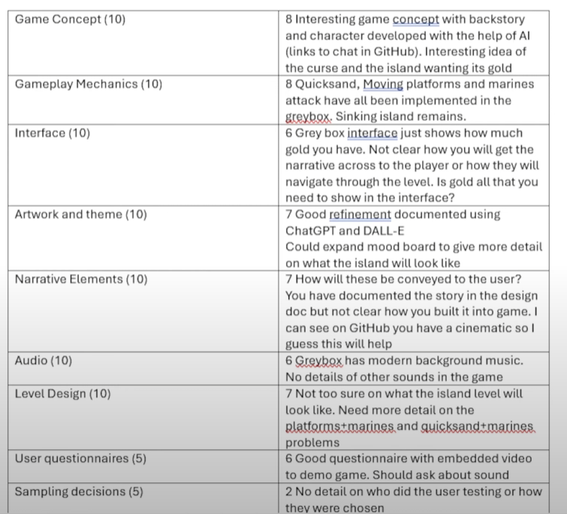
Concept/Greybox Feedback from Lectures

Slide 25
Improvements done in Alpha
Cinematic implemented
Gold + Villagers Saved showed in HUD
Island references included in the doc.
Cinematic added
Page in this Design Doc explaining narrative
Page added to doc
Many audios already implemented
New questionnaire for Alpha

Slide 26
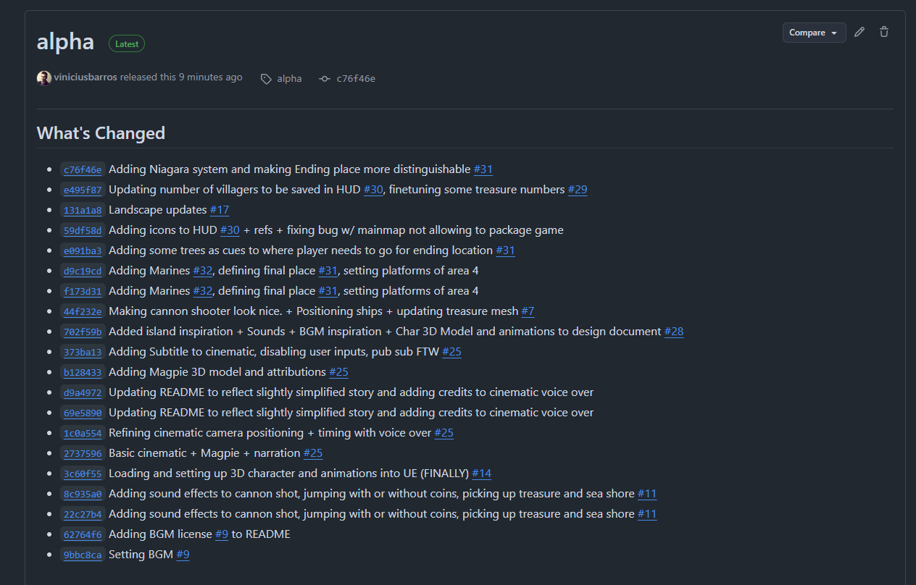
Alpha main changes

Slide 27
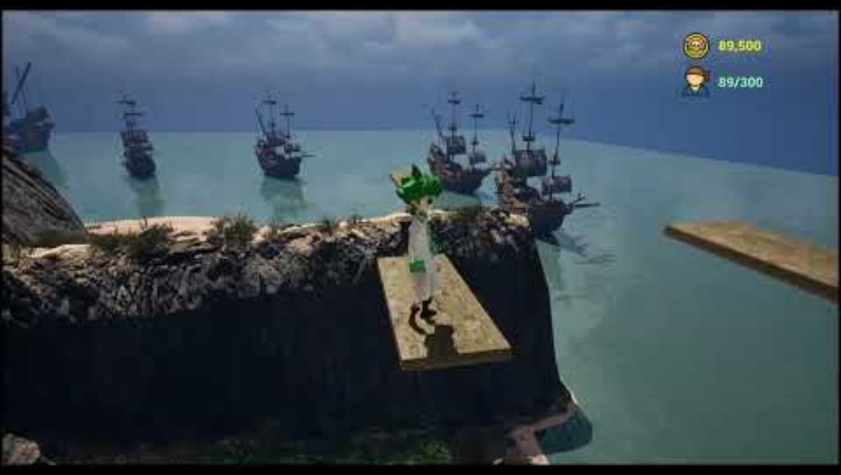
Alpha Gameplay
Download Alpha Build

Slide 28
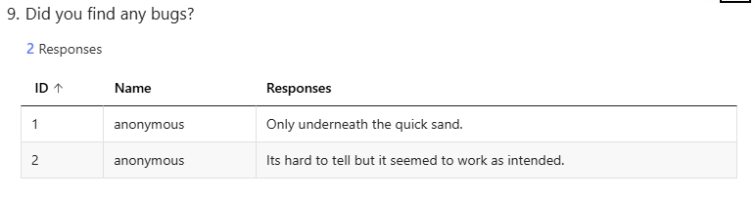
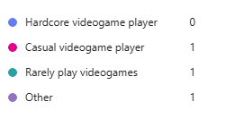
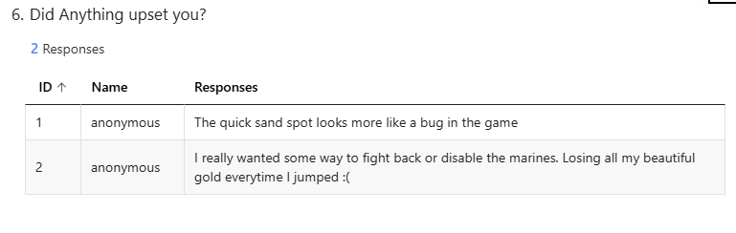
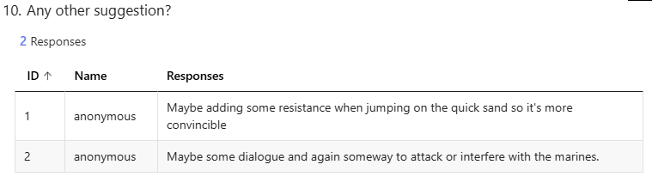



Alpha Feedback
10 questions asked in Online Form
3 answers so far

Slide 29

The
Skybound
Gold
Thank you

Slide 30




Credits
This presentation template is free for everyone to use thanks to the following:
SlidesCarnival for the presentation template
Pexels and Pixabay for the photos
Happy Designing!

